Slide 1
Intro to R
February 24, 2017
Joel Herndon and John Little
askdata@duke.edu
Notes:
Conventions- courier font means code

Slide 2
Goals for Today’s Workshop
Learn how to work with R using Rstudio
Be able to load data into R for analysis
Learn how to manage/clean/analyze data in R
ALSO: Answer your questions about R! (just ask anytime)
ALSO: Some previews of cool things you can do with R.

Slide 3
Assumptions for today’s class*
We will focus on data frames in R
We will focus on numeric and text data
We won’t worry about missing data
*We’re happy to discuss things beyond this focus! (or address questions about missing data)

Slide 4
Why R?
R is a powerful tool for stats, but it can also...

Slide 5
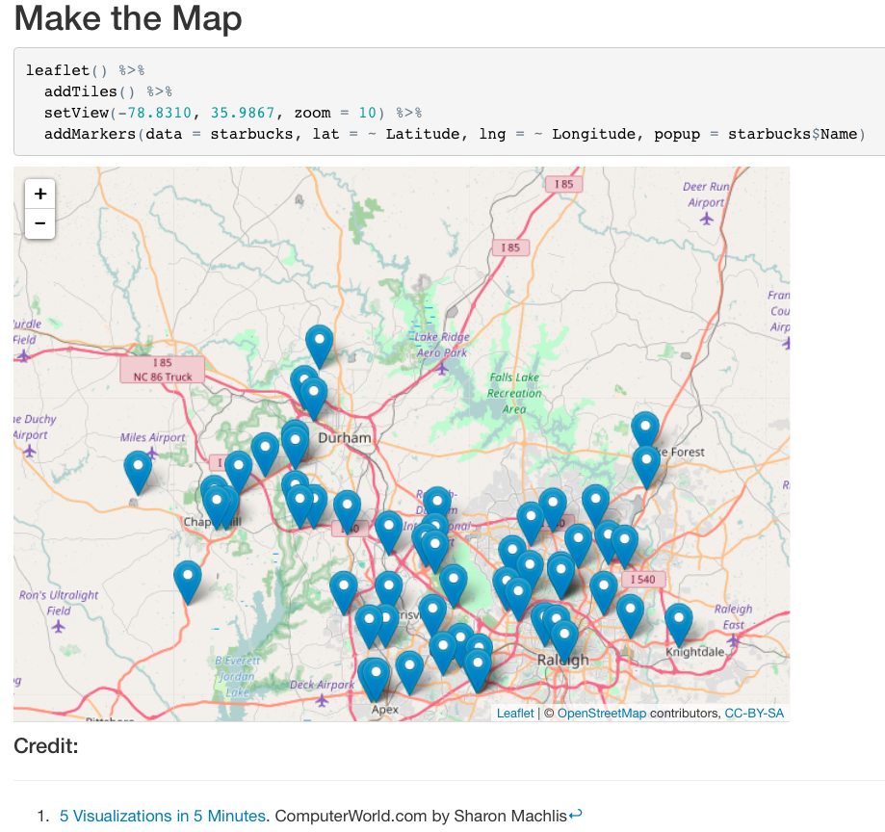
Create data driven maps...

Slide 6
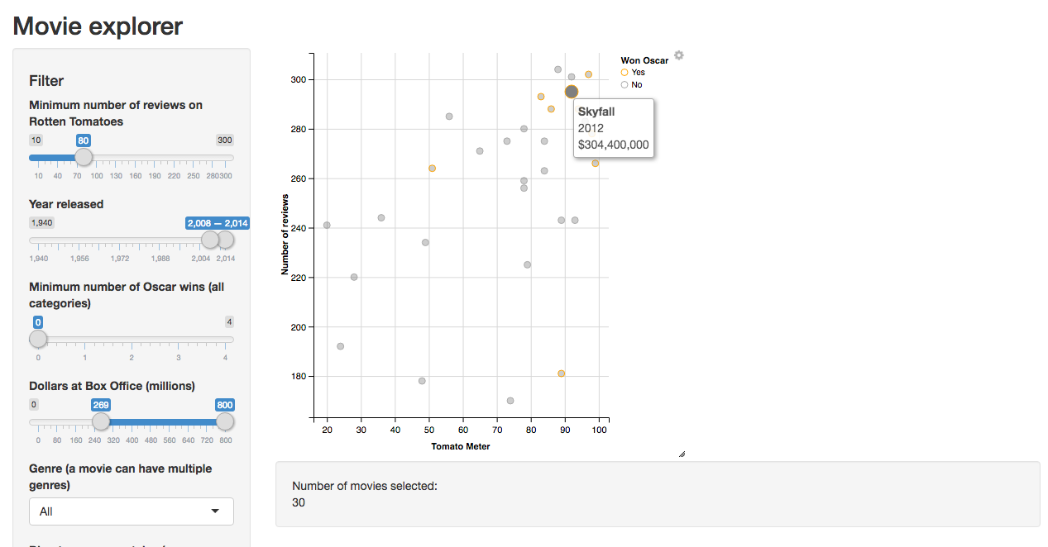
Create a interactive website...
http://shiny.rstudio.com/gallery/movie-explorer.html

Slide 7
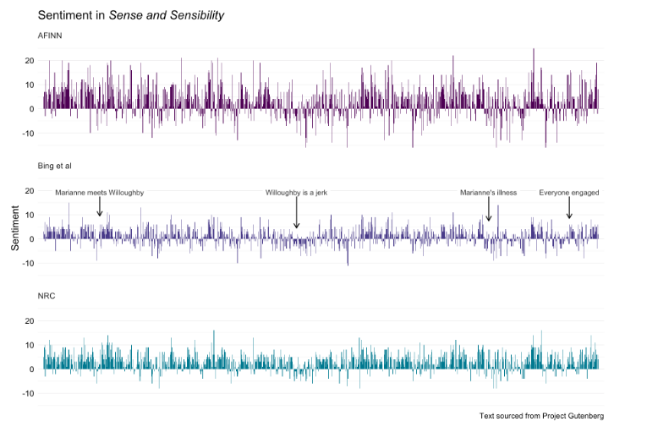
Text/sentiment analysis...
http://juliasilge.com/blog/If-I-Loved-NLP-Less/

Slide 8
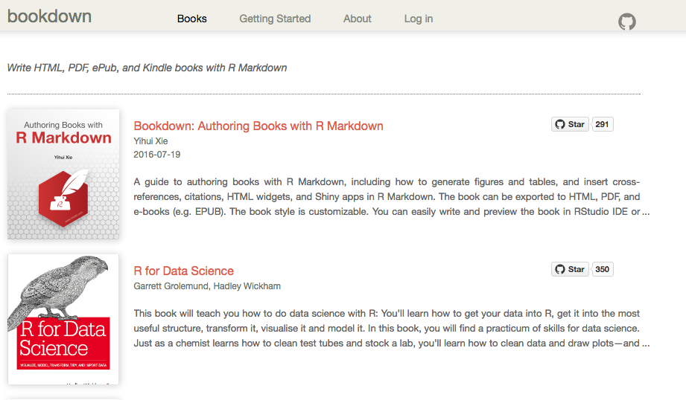
Create an article, book, presentation…
bookdown.org

Slide 9




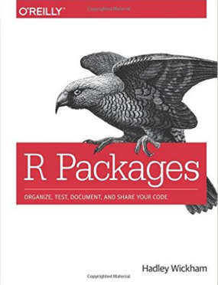



Extending R
...And many more....

Slide 10
Background
Notes:
1. How many people have used a statistics package before? Which packages?
2. How many people have coded using a programming language before? Which languages?
3. How many of you have to use R for class? your own research? just interested?

Slide 11


Getting R - R and R Studio
I’m the open source statistical programming language.
I’m a development environment for using the R programming language.

Slide 12
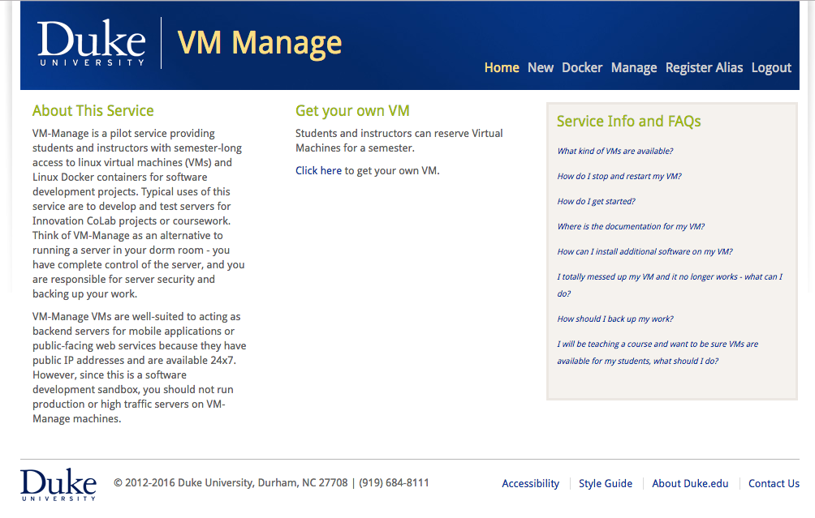
vm-manage.oit.duke.edu

Slide 13
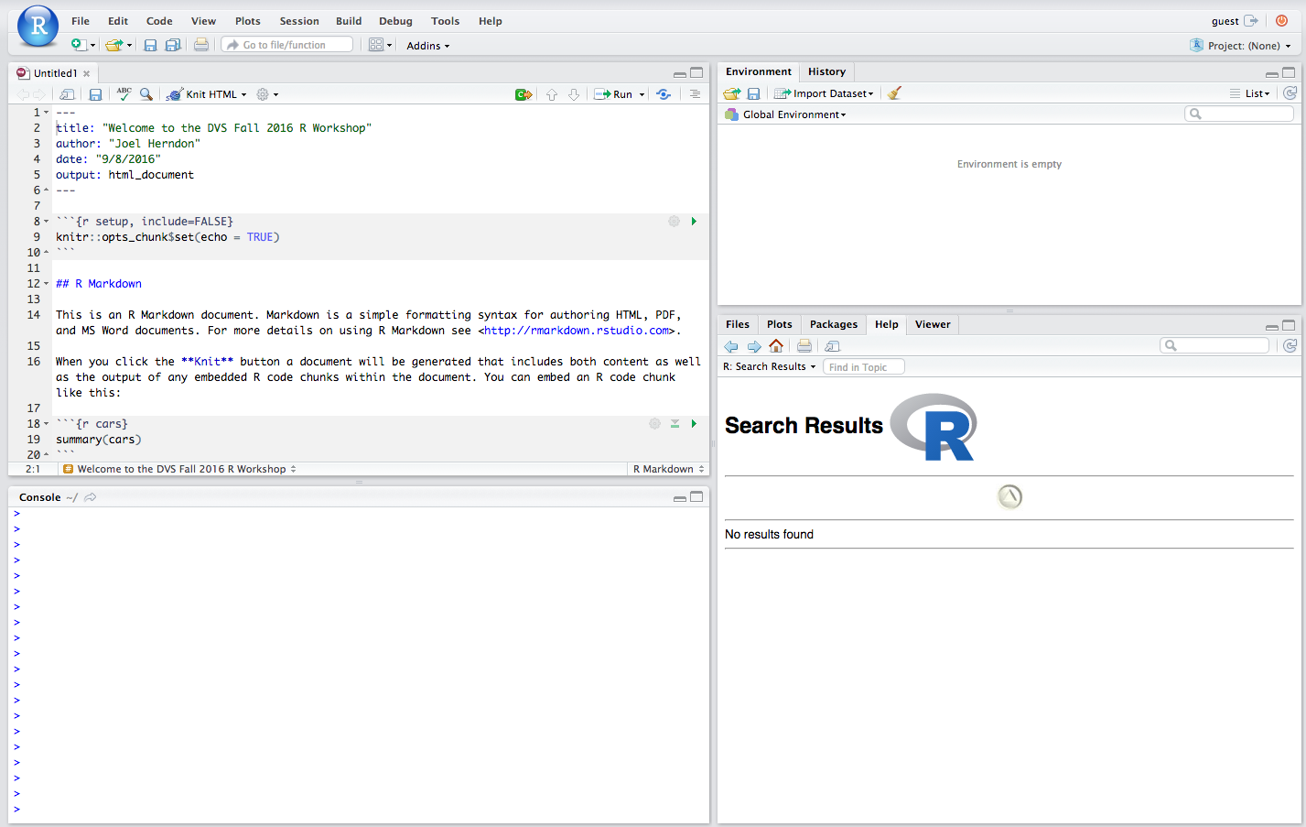

Slide 14
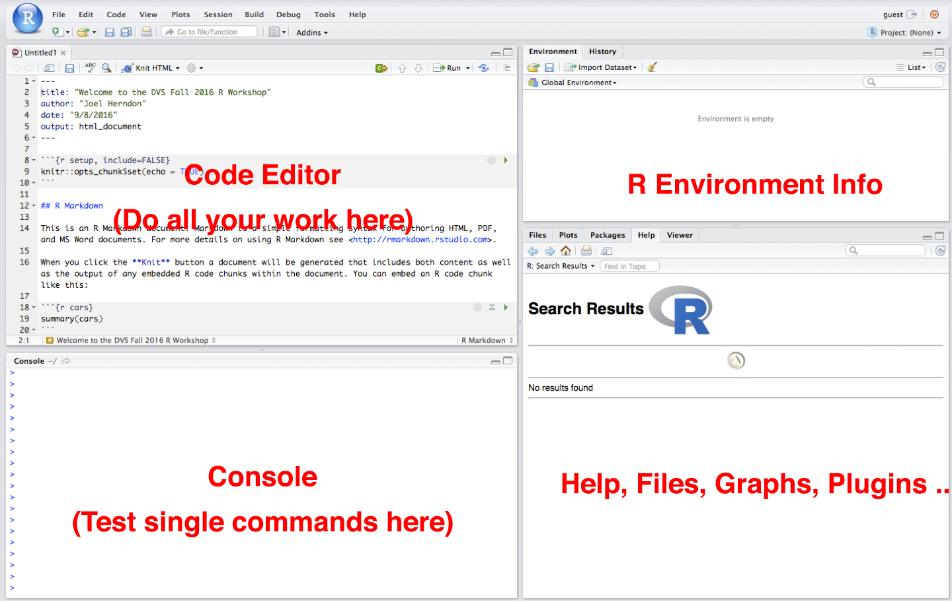

Slide 15
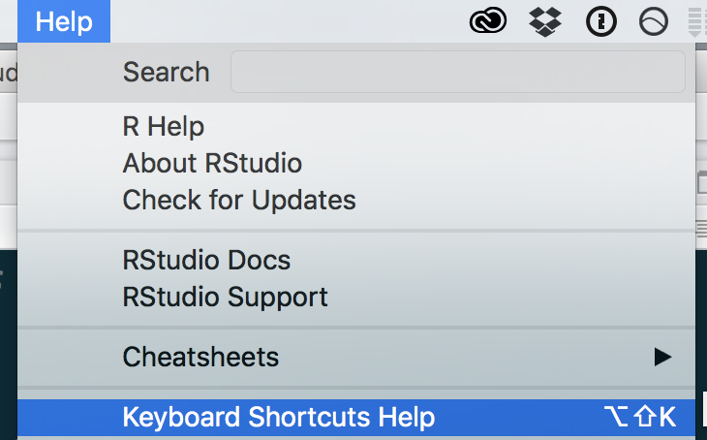
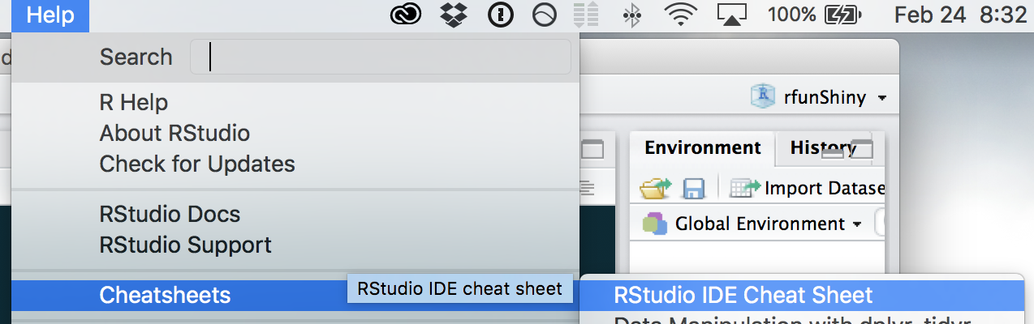
References for the Rstudio Interface
The “Help” menu in Rstudio contains a number of guides, cheatsheets, and handy keyboard shortcuts.

Slide 16
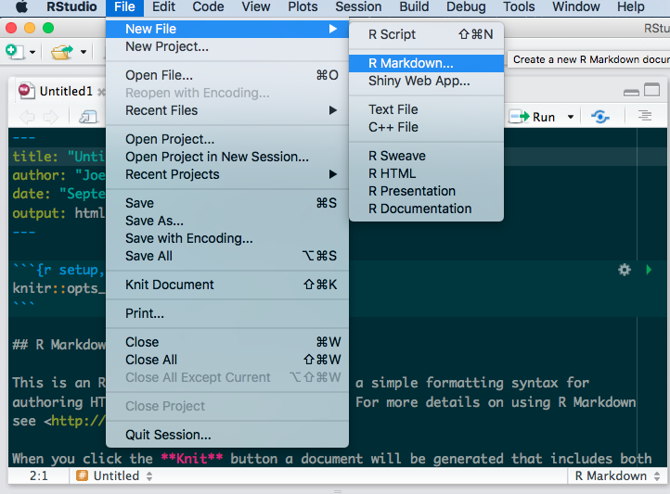
Writing Code in R
R provides several options for writing code

Slide 17
R Markdown
We are using R Markdown today (files that end in .Rmd)
R Markdown allows us to write regular text and add R code chunks that run code in R
R Markdown helps us to share code with context (or to write code in a way that you can remember what it does later.
R Markdown also allows us to output our text and R results as HTML, PDF, or Word documents.

Slide 18
R Markdown
In R Markdown R code is placed inside special code “blocks” that resemble the example below:
```{r}
R code goes here
```
Regular text appears through the rest of the document
You can read more about formatting your text in the markdown reference in the ”Help” menu.

Slide 19
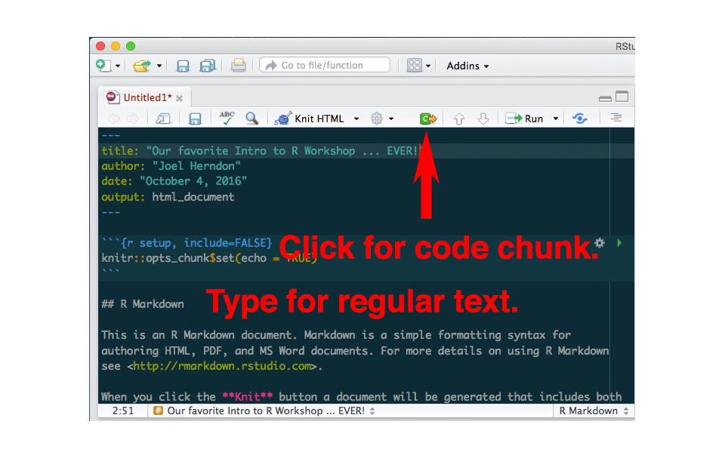
R Markdown

Slide 20
Files and projects
Intro2R

Slide 21
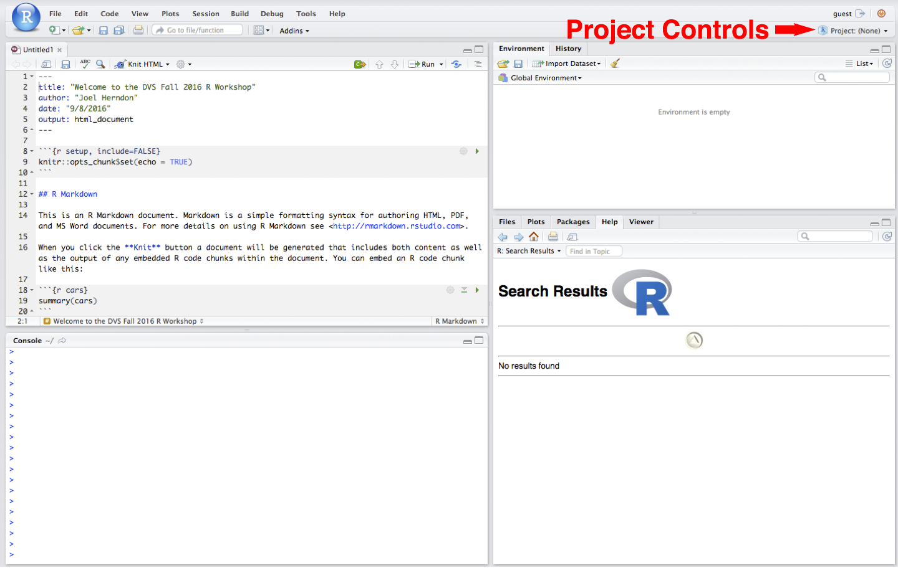

Slide 22
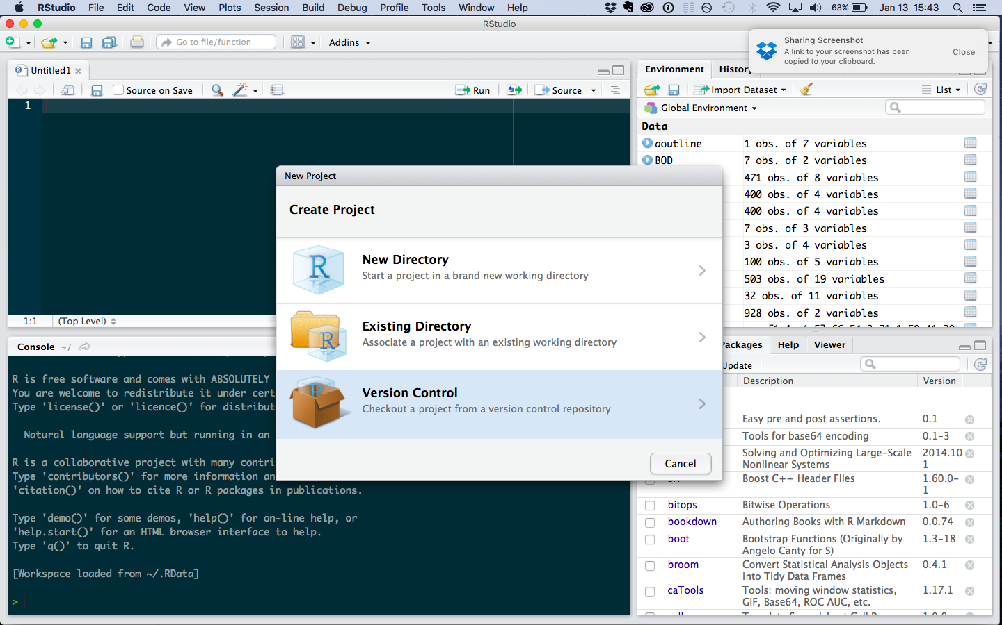

Slide 23
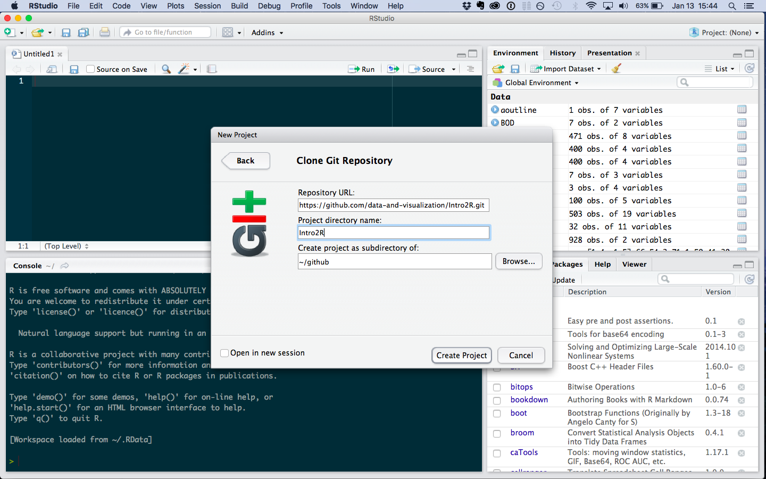

Slide 24
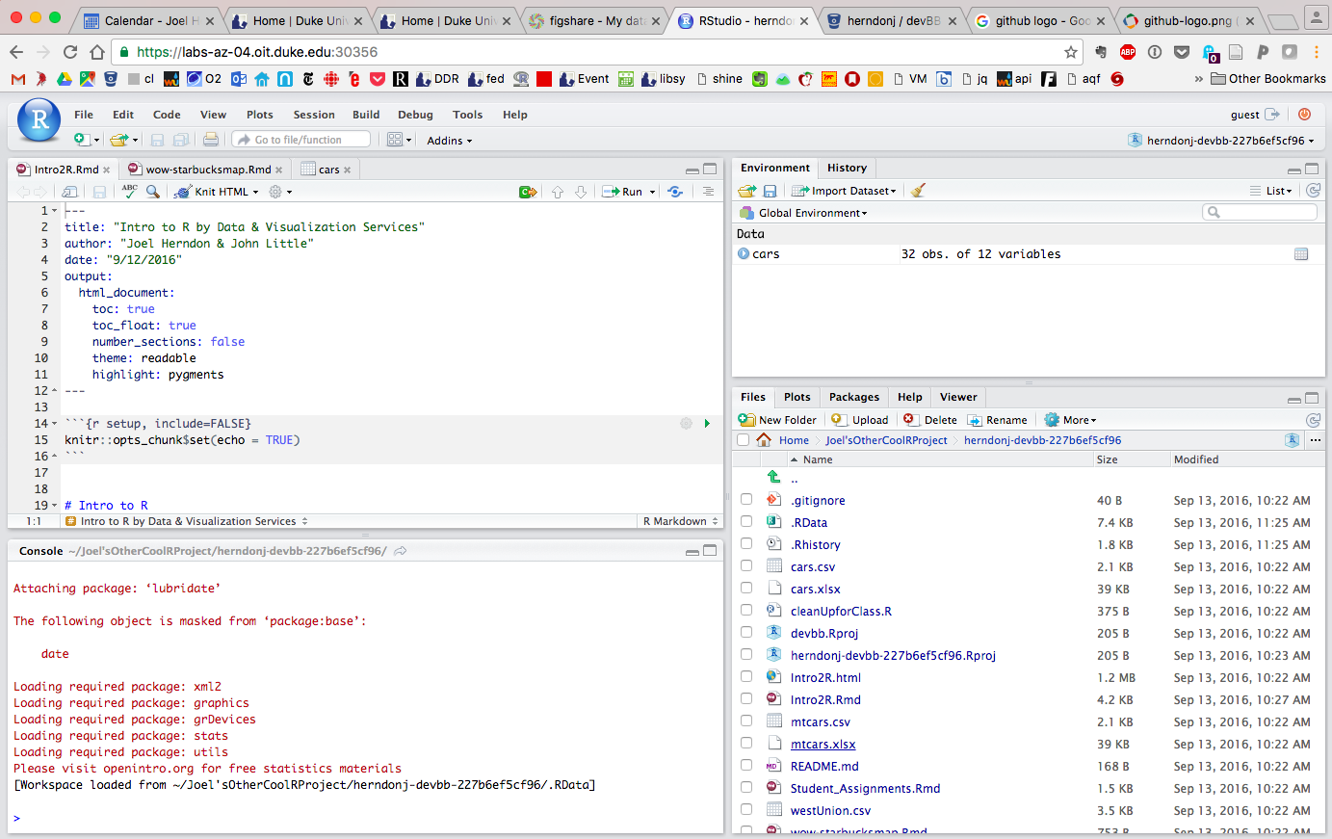

Slide 25
HELP!

Slide 26


http://r4ds.had.co.nz/
http://www.statmethods.net/

Slide 27




Getting Help Online
Google – add“r” or “rstats” to your search
Stack Overflow – add “[r]” to your search
rseek.org (Google, but focused on R)
Quick R – statmethods.net

Slide 28
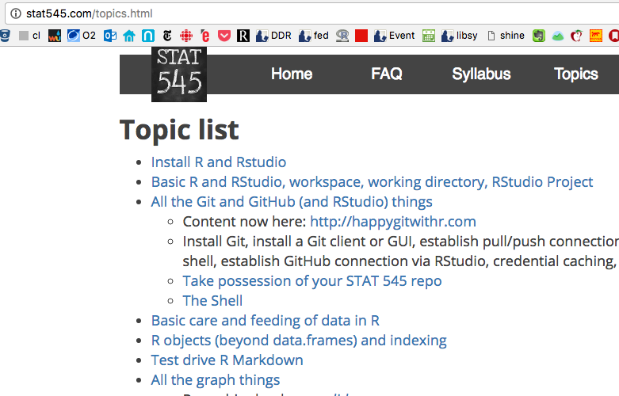
Stat545 – Jenny Bryan’s UBC Course on Stats in R
Notes:
And a personal favorite....

Slide 29
Getting Help At the Command Line
help(functionName) or ?functionName
??topic #search the help system
appropos(“topic”)
vignette(“topic”)

Slide 30
A few syntax tips before we start:
Assignment in R uses <- to assign values to variables
R uses == to represent equality of values
R uses the %>% symbol to represent a pipe that moves the output of one operation to another operation.

